Slide 1
Feature Extraction From Text
Renato R. Maaliw III, DIT
College of Engineering
Southern Luzon State University
Lucban, Quezon, Philippines

Slide 2
Most classic machine learning algorithms cannot take in raw text
Instead we need to perform a feature “extraction” from the raw text in order to pass numerical features to the machine learning algorithm

Slide 3
For example, we could count the occurrence of each word to map text to a number
Counter Vectorization, Term-Frequency and Inverse Document Frequency

Slide 4
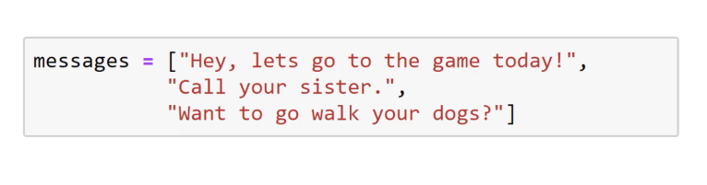
Count Vectorization

Slide 5
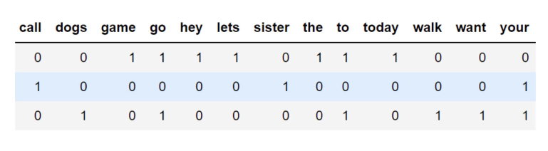
Document Term Matrix (DTM)

Slide 6
An alternative to CountVectorizer is a TfidfVectorizer. It also creates a document term matrix from our messages.
However, instead of filling the DTM with token counts it calculates term frequency-inverse document frequency value for each word (TF-IDF)

Slide 7
Term frequency tf(t,d): is the raw count of a term in a document, i.e the number of times that term t occurs in a document d
However, instead of filling the DTM with token counts it calculates term frequency-inverse document frequency value for each word (TF-IDF)

Slide 8
However, Term Frequency alone isn’t enough for a thorough feature analysis of the text.
Let’s imagine very common terms, like “a” or “the”

Slide 9
Because the term “the” is so common, term frequency will tend to incorrectly emphasize documents which happen to use the word “the” more frequently, without giving enough weight to the more meaningful terms “red” and “dogs”

Slide 10
An inverse document frequency factor is incorporated which diminishes the weight of terms that occur very frequently in the document set and increases the weight of terms that occur rarely.

Slide 11
It is the logarithmically scaled inverse fraction of the documents that contain the word (obtained by dividing the total number of documents by the number of documents containing the term, and then taking the logarithm of that quotient)

Slide 12
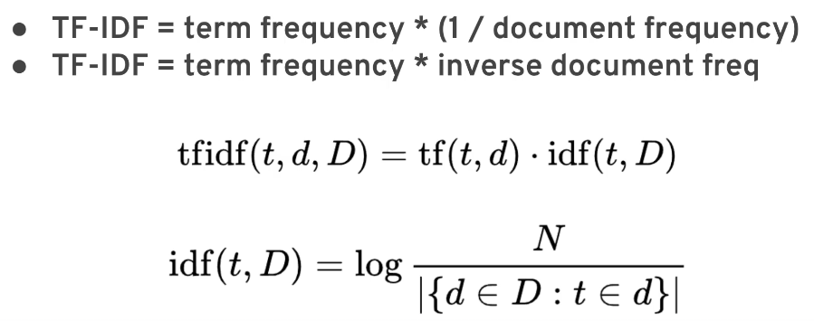

Slide 13
Fortunately Scikit-learn can calculate all these terms for us through the use of its API
Notice how similar the syntax is to our previous use of ML models in Scikit-learn

Slide 14
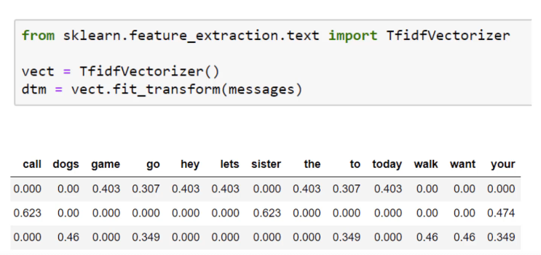

Slide 15
TF-IDF allows us to understand the context of words across an entire corpus of document, instead of just its relative importance in a single document

Slide 16
[Code Demo]

Slide 17
Thank you very much for listening.

